Slide 1
About Educational Activities

Slide 2



Indian Institute of Materials Management Bangalore Branch
A National Body of Materials & Supply Chain Management Professionals

Slide 3
About IIMM

Slide 4

Headquarters at Navi Mumbai
Not-for-Profit Organization
National Apex body representing a wide spectrum of SCM professionals
52 branches and 19 chapters, around 9500 members
Dedicated to the promotion of Materials Management
About IIMM

Slide 5
IIMM Activities & Membership
Professional Development Activities
- Round Table deliberations.
Consultancy
- Consultancy services in
Materials Management,
Logistics and
Supply Chain Management
covering detailed study, interactive sessions, recommendations, Manual preparation, implementation and monitoring.
- Study Circle meetings.
- Evening Lecture Programs.
- Young Materials Managers Competition.
- Regional Conferences.
- Annual National Convention.
- World Congress of IFPSM.
- Supply Chain and Logistics Exposition (SCALE)
- MM Week / MM Day Celebrations in April
- Complimentary Journal from IFPSM and IIMM
Training Programs
-Executive Development Programs.
- Workshops
- Advanced Materials Management Programs.
- In-plant Training Programs (specially designed)

Slide 6
IIMM Activities & Membership
Education
- CSCM
- Certificate Course in Supply Chain Management
- Modular Courses on Specific subjects
- PGDMM / PGDSCM &L
Research
- Center for Research in Materials Management (CRIMM) at Kolkata ,a joint venture with Techno India University.
Membership
- Fellow Member
- Member
- Associate Member
- Institutional Member
- Large scale
- Small Scale
- Life Member
- Life Fellow Member
- Student Member
Contact
Nagaraj SM
Phone: 25327251 /52
Tele Fax: 25327253
Mobile: 9900862486, 9972441466
e-mail nagaraj.sm@iimmbangalore.org
iimmbg@airtelmail.in
Web: www.iimm.org &
www.iimmbangalore.org

Slide 7

MC xM
(Modular Certification in
Xxxxx
Management)

Slide 8
MCxM
01 Purchasing Management
02 International Trade
03 Logistics Management
04 Inventory Management
05 Information Technology & E-Commerce
06 Operations Management

Slide 9
MCxM Course Details
Content : Enclosed Following slides
Courses : MCPM - Modular Certification in Purchase Management
        MCIM - Modular Certification in Inventory Management
        MCLM - Modular Certification in Logistics Management
        MCITD - Modular Certification in International Trade Management
        MCITEC - Modular Certification in Information Technology & E-commerce
        MCOM - Modular Certification in Operations Management
Duration : 2 week ends (Sat & Sun)
Total Time : 18 hours + 2 Hours Examination
Timing : 10 am to 1 pm (Mor), 2 pm to 5 pm (Anoon)
Course Fees : Rs 10,000 + GST

Slide 10

01 Purchasing Management
01 Purchasing & Supply management
02 Supply Strategy /03 Supply Organization
04 Supply Process & Technology
05 Make or Buy Insourcing or Outsourcing
06 Need Identification & Supply Chain
07 Quality / 08 Quantity & Inventory
09 Delivery / 10 Price
11 Cost Management /12 Supplier Selection
13 Supplier Evaluation & Relationships
14 Global Supplier Management
15 Legal & Ethics /16 Other Responsibilities
17 Supply Function Evaluation & Trends

Slide 11
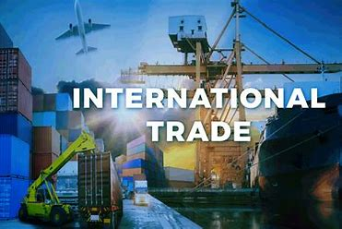
02 International Trade
01 Need for International trade
02 IPLC & Challenges
03 Trade Imbalances
04 Global Scenario & MNC
05 Role of Government & Acts
06 Import Liberalization
07 Trade Economics & conventions
08 Trade Policy Implementation instruments
09 Role of Customs
10 Exchange Rate & FEMA
11 IMF & EPS
12 Export & Payment Procedures

Slide 12
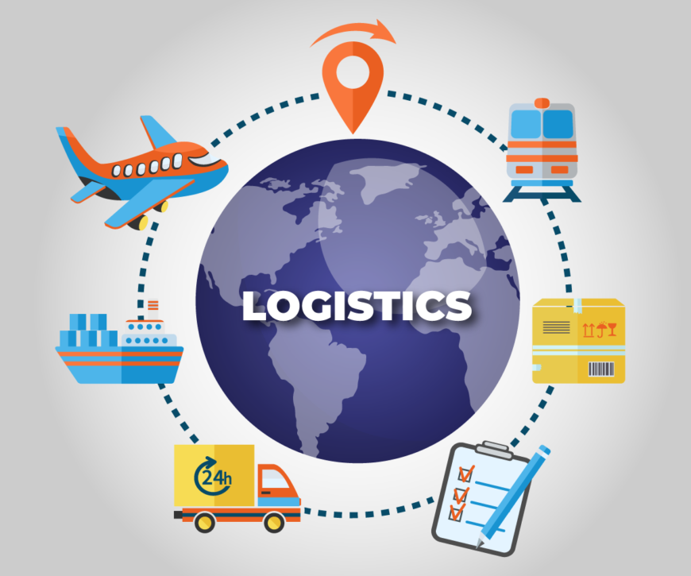
03 Logistics Management
01 Objectives
02 SCM
03 Storage Systems
04 Physical Distribution
05 Role of Air Cargo
06 Warehouse Management System
07 Containerization
08 Logistics Quality
09 Resilience in Global supply Chain
10 Distribution
11 Packaging
12 Ocean Transportation

Slide 13
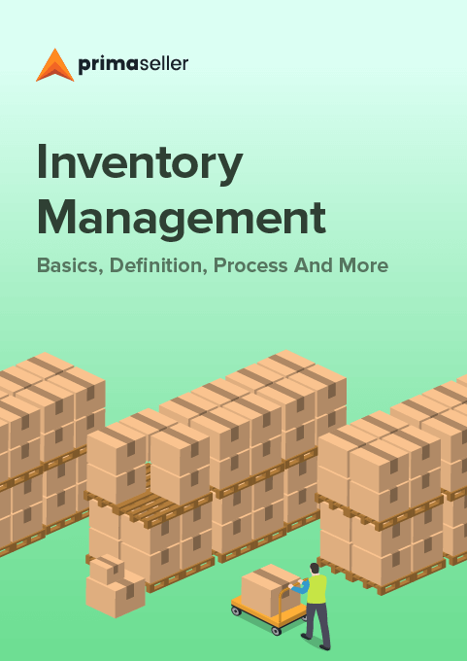
04 Inventory Management
01 Introduction
02 Costs Associated with Inventory
03 Classification of Inventories
04 Inventory Management Techniques I
05 Inventory Management Techniques I I
06 Demand Forecasting
07 Lean Management
08 TQM
09 MRP
10 Surplus Obsolete Non-Moving Inventory
11 WIP VMI
12 FGI & Spares

Slide 14

05 Information Technology &
E-Commerce
01 Fundamentals of Computers
02 Evolution of Computers
03 Operating Systems
04 Information Systems
05 DBMS
06 Information Technology
07 Internet
08 E-Commerce
09 B2B E-Commerce
10 E-Governance
11 Legal Aspects
12 ERP

Slide 15

06 Operations Management
01 Production & Operations Management
02 Operations Strategy
03 Demand Forecasting
04 Design of Production Process
05 Facility Planning
06 PPC
07 Resources Planning
08 Shop Floor Planning & control
09 Purchase & Inventory Management
10 Job Design & Ergonomics
11 Employee Productivity
12 Total Productive Maintenance

Slide 16
Thank You

Slide 17

Indian Institute of Materials Management Bangalore Branch
IIMM Inhouse, Consultancy, Customized Programs

Slide 18
Some of our Valued Customers

Slide 19





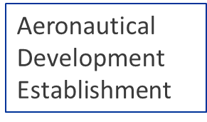

Slide 20






Slide 21




Slide 22


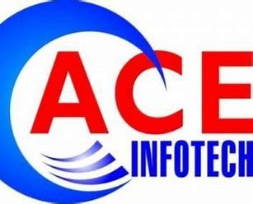




Slide 23






Slide 24
Robert Bosch Engineering & Business Solutions
Vivekananda College
Seshadri Puram College

Slide 25






Slide 26







Slide 27

Thank You
Thank You

Slide 28
IIMM Faculty

Slide 29
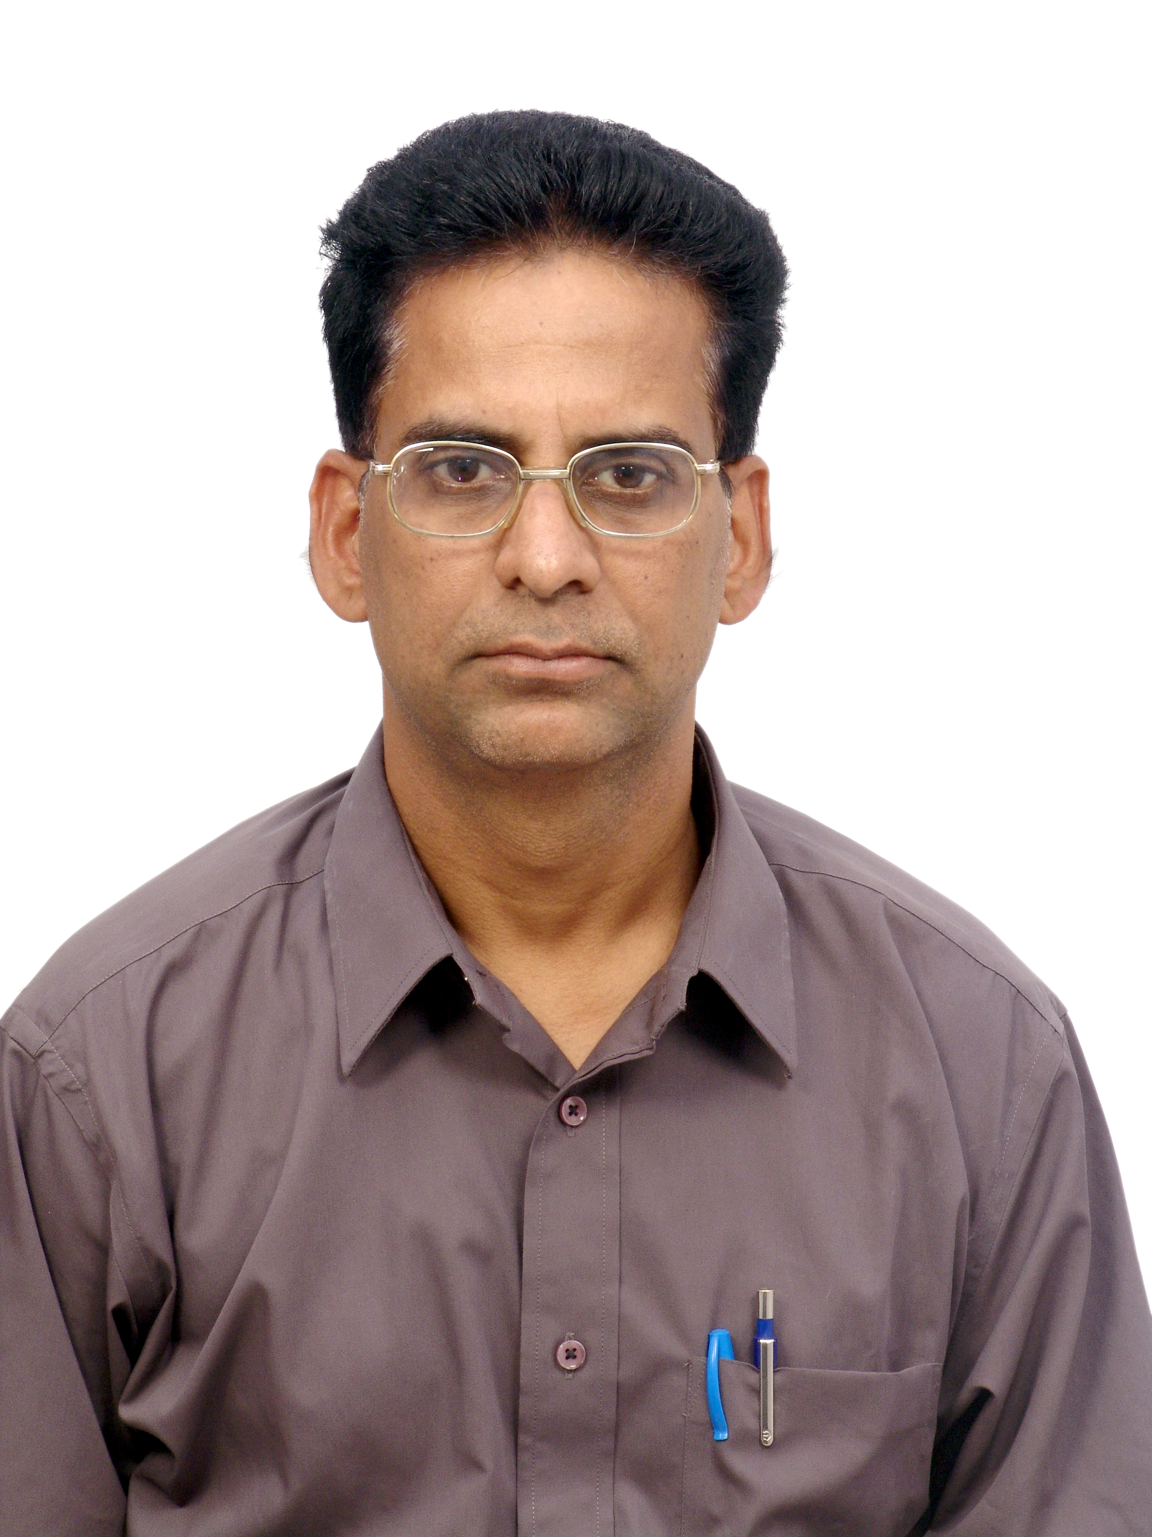
Balasubramanian Gurumoorthy
Profession:
          Senior Faculty at IIMM
          Independent Consultant
Academics:
          B.E (Mechanical), NIT Allahabad
          MBA, Anna University
          MS BITS, Pilani
          GDMM, IIMM
          Experience:
          35 Plus Years in
          28 years at TATA Elxsi in Purchasing
          7 years at BPL in PPIC
Professional Journey:
          General Manager (Materials), TATA Elxsi
Certifications:
          GDMM . PGDFTM

Slide 30
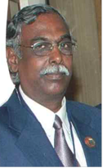
M S Shankar Narayanan
Profession:
          SCM – Consultant
          General Manager, Retd., BHEL, Electronics Division, Bangalore)
          Past Chairman of IIMM
          Academics:
          BE (ECE), ME (comm. System),
          MBA (Fin. Mgmt)]
  Experience:
    25 plus years
            10 Years in production, 10 Years in Material Management, 4 Years in Import – Export, licensing, 8 years in implementing MM Module etc
Professional Journey:
            Experience in all areas of Supply chain including Manufacturing, Material Planning, Shop Planning, Logistic Planning, Stores Management.
            Visited UK, France, Netherlands, Germany, Austria etc for training in various areas of manufacturing
            Awarded as Best Faculty on the Occasion NATCOM - 2016

Slide 31

Thank You

